Slide 1
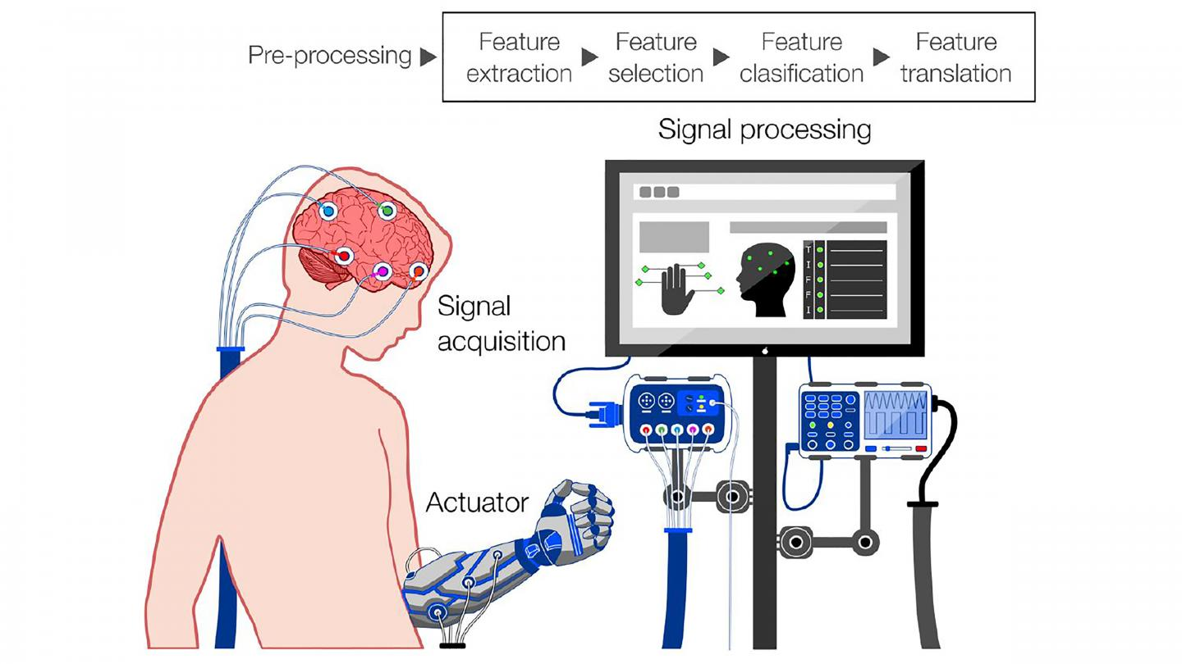
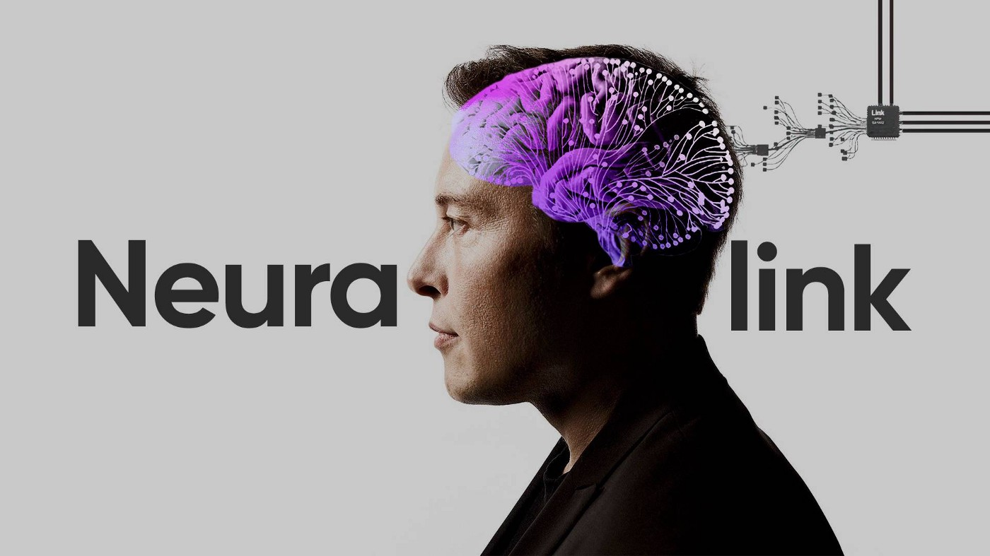
Introduction to Modern Non-invasive Brain-Computer Interface Technology
https://publishing.aip.org/publications/latest-content/bleak-cyborg-future-from-brain-computer-interfaces-if-were-not-careful/
https://www.firstpost.com/tech/news-analysis/what-is-neurotechnology-and-brain-computer-interface-the-tech-that-elon-musks-neuralink-uses-11730351.html

Slide 2
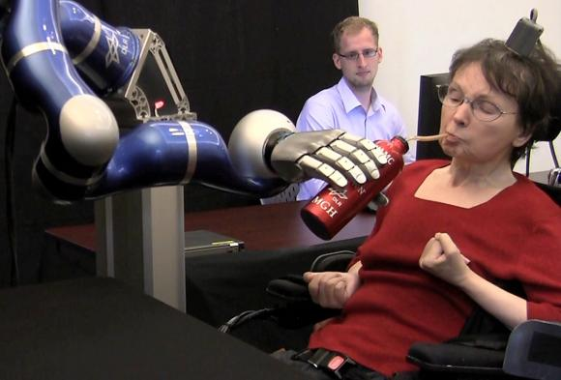
About this course
Pilot Course, U.S. College Style
Interdisciplinary
Neuroscience
Physics
Math
Electrical Engineering
Computer Engineering
Computer Science (Machine Learning)
Systems Engineering
Opportunity for Publication!
https://news.brown.edu/articles/2012/05/braingate2

Slide 3
Course Expectation
Respect each other
Be curious! Ask questions!
No electronics during lecture time
Attend class on time, go to lab session on time

Slide 4
Tentative Course Outline
Week 0
Introduction to Modern Brain-Computer Interface applications
No Lab
Week 1
Introduction to Computers
Lab 1: Introduction to Python
Week 2
Basic Neuroscience
Lab 2: Intermediate Python
Week 3
Recording Techniques: Invasive v.s. Non-invasive
Lab 3: Introducing EEG recording system & live data collection
Week 4
Signal Processing Part 1
Lab 4: Implement an audio filter
Week 5
Signal Processing Part 2
Lab 5: Frequency domain analysis – Fourier Transform
Week 6
Signal Processing Part 3 – advanced method
Lab 6: Independent Component Analysis (ICA)

Slide 5
Week 7 - 8
Machine Learning (Supervised v.s. Unsupervised)
Week 9
Systematic Thinking in BCI (Closed-Loop v.s. Open-Loop)
Week 10
Putting Everything together, how to build a BCI system from scratch
Week 11
Other Interesting Topics (Virtual Reality, Bioethics etc.)
Week 12 – 15
Literature Reading
Week 16 – 19:
Final Presentation In-class working time
Final Week
Presentation

Slide 6
Syllabus
Office Hour:
Email:
Tentative Grading:
50% Lab
30% Final Presentation
10% Class attendance and participation
10% In-Class Quiz
Extra credit opportunity available

Slide 7
Assignment
Find a BCI application and share with the class in the next lecture

Slide 8
Class Reading
https://waitbutwhy.com/2017/04/neuralink-cleanversion.html

Slide 9
Lecture 0 Introduction to Brain-Computer Interface applications

Slide 10
What is Brain-Computer Interface?
A direct communication pathway between the brain’s electrical activity and an external device, most commonly a computer or robotic limb (Wikipedia)

Slide 11
Major BCI application areas
1. Steady-state visual evoked potentials (SSVEP)
2. Motor Imagery
3. P300

Slide 12
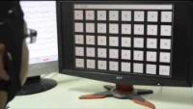
Brain-Computer Interface: SSVEP Speller
Chen, Xiaogang, et al. "High-speed spelling with a noninvasive brain–computer interface." Proceedings of the national academy of sciences 112.44 (2015): E6058-E6067.

Slide 13
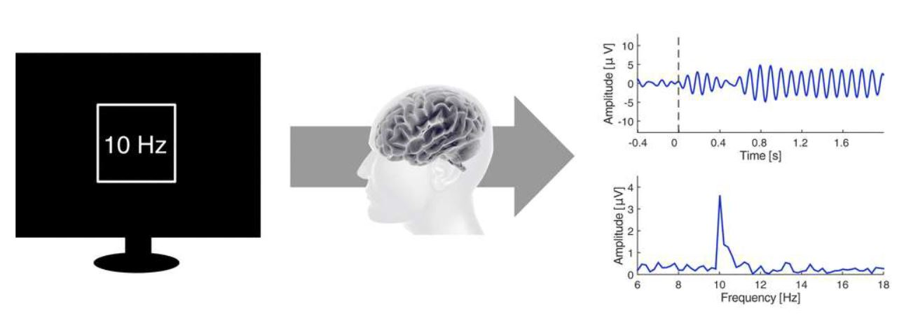
Steady-state visual evoked potentials (SSVEP)
-The SSVEP is the EEG response evoked by visual stimuli that are presented at a specific frequency, which results in an increase in the EEG at that same frequency (Yang, 2022)
Vialatte et al., Prog. Neurobiol., 90(4): 418-438, 2010

Slide 14
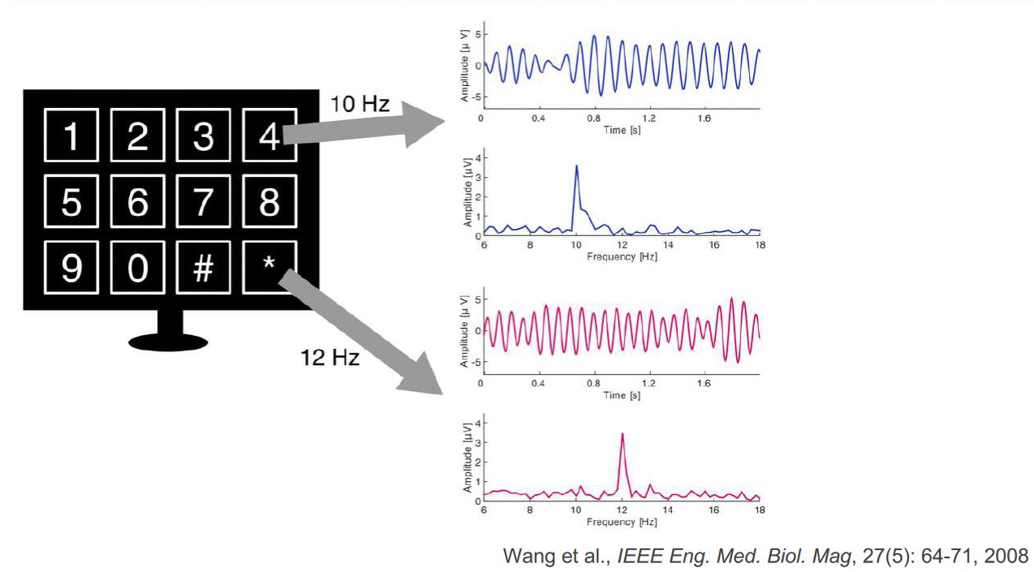
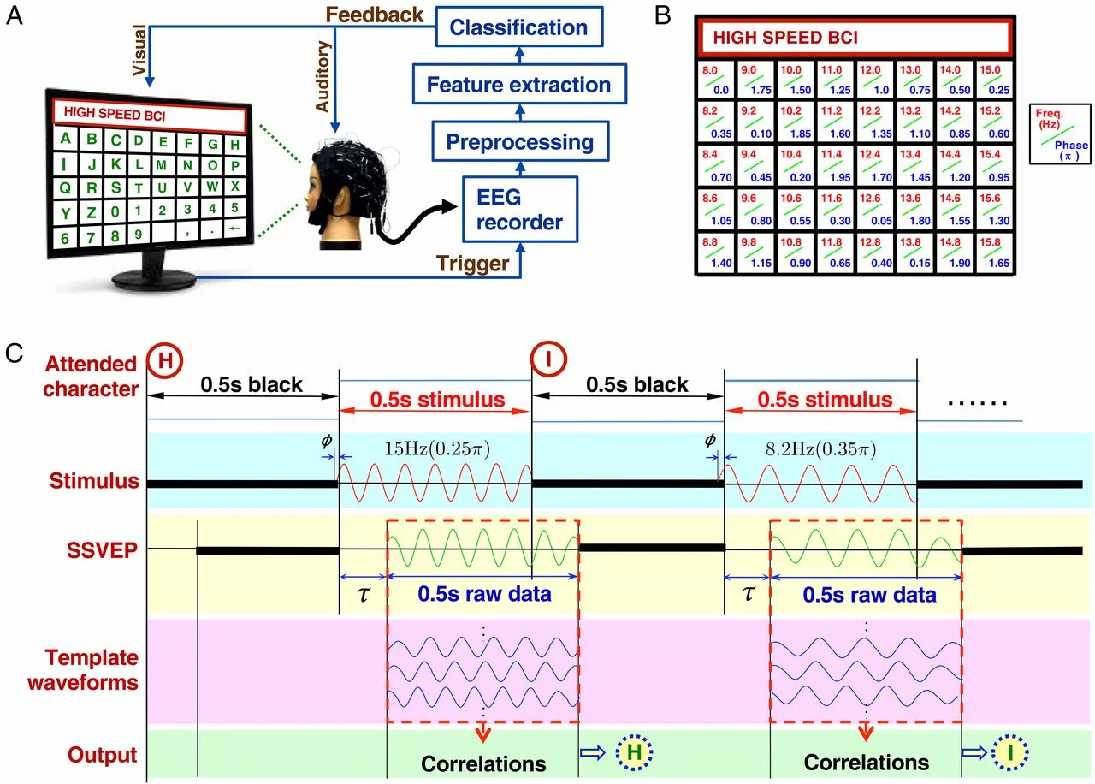
SSVEP based BCI
Nakanishi, 2015

Slide 15
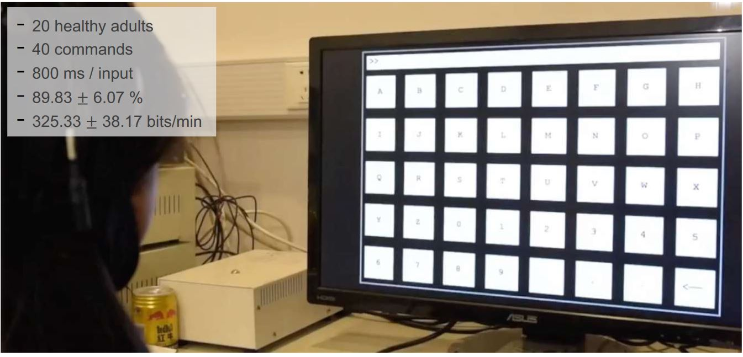
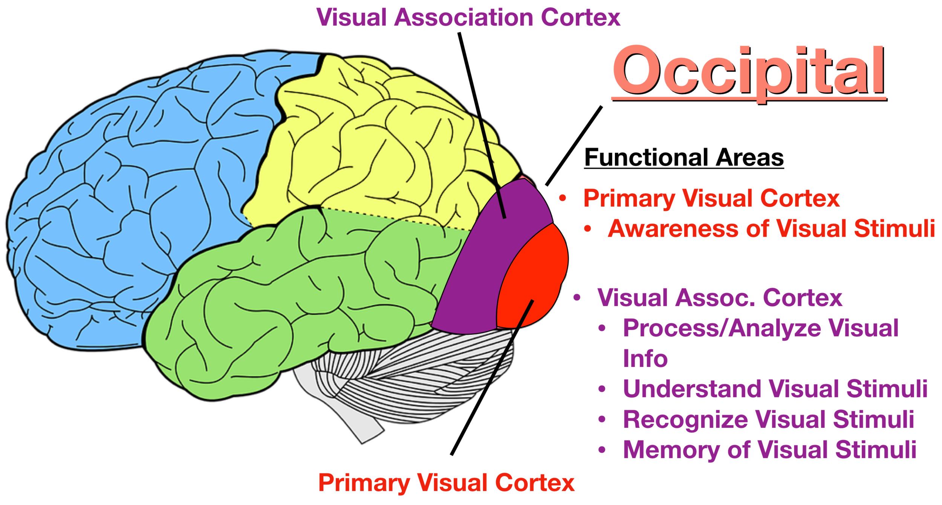
Nakanishi, 2015

Slide 16
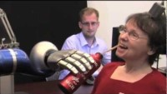
Brain-Computer Interface: Motor Imagery

Slide 17
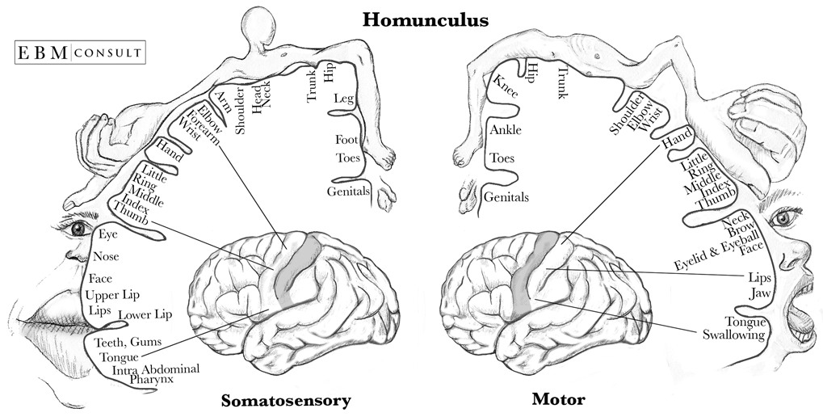
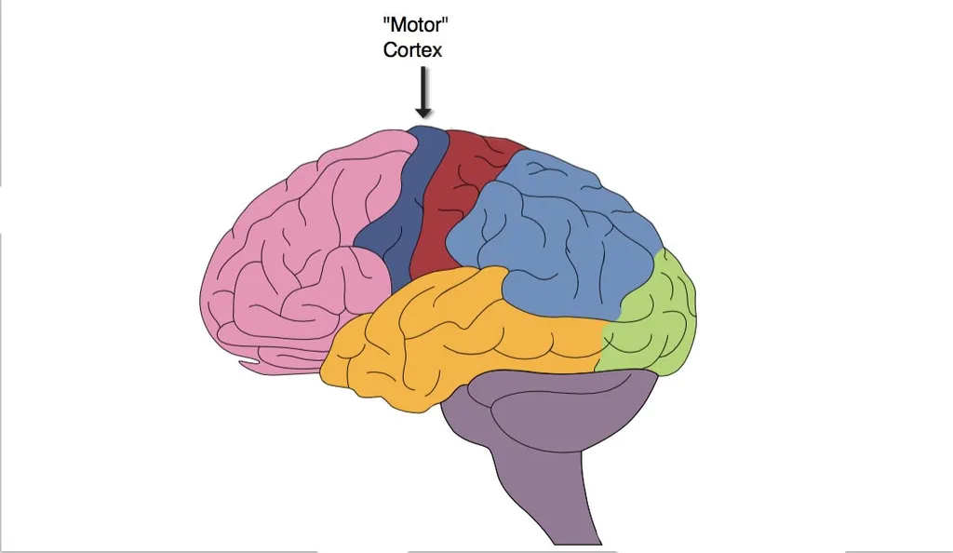
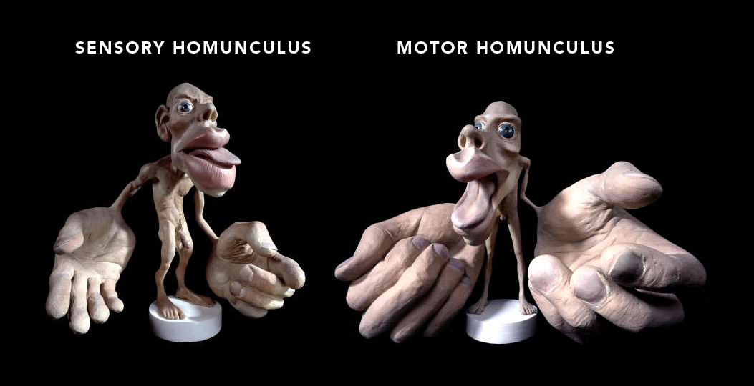
Motor Imagery
The term motor imagery (MI) refers to the mental simulation of body movements (Scherer, 2018)
https://www.ebmconsult.com/articles/homunculus-sensory-motor-cortex
https://www.simplypsychology.org/motor-cortex.html
https://learnsomatics.ie/how-your-brain-sees-your-body/

Slide 18
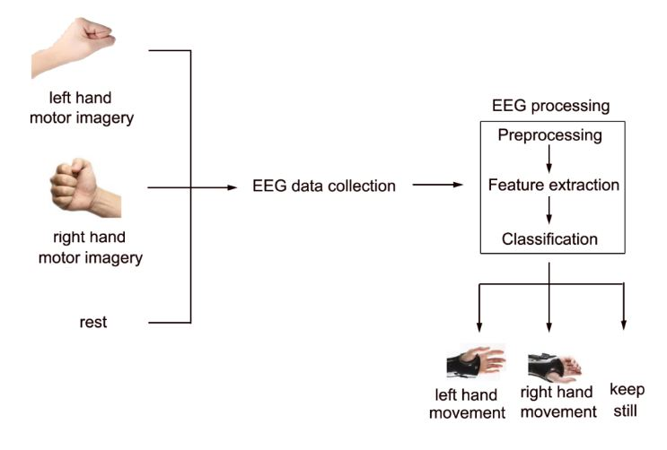
How does it Motor Imagery BCI work?
Gao et.al, 2016
Notes:
https://aip.scitation.org/doi/pdf/10.1063/1.4959983

Slide 19
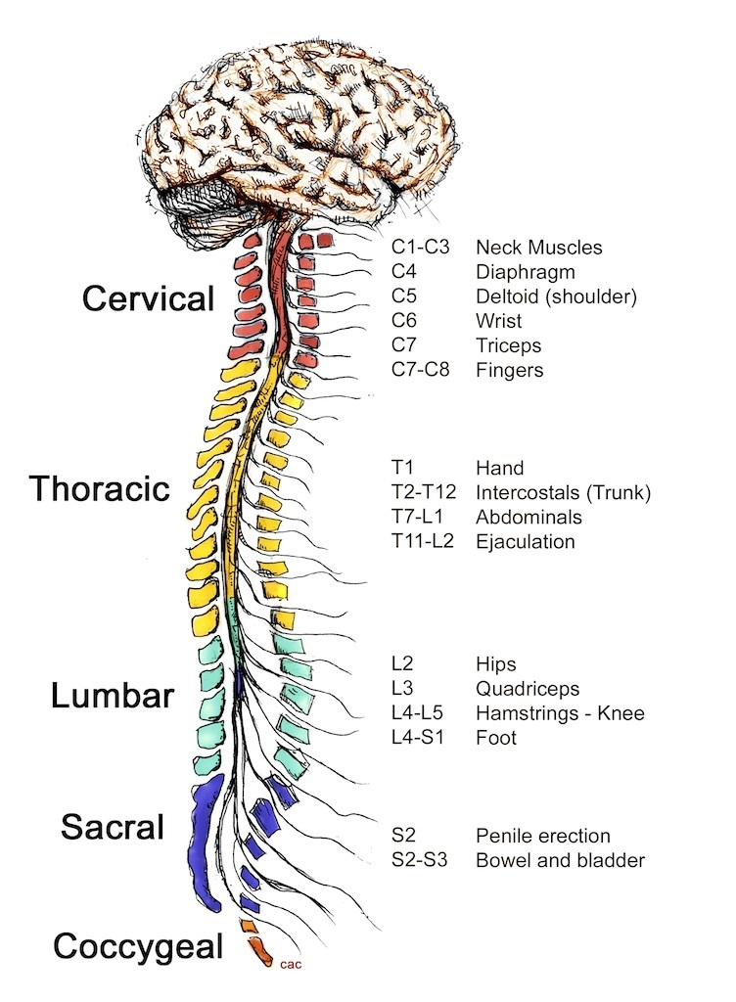
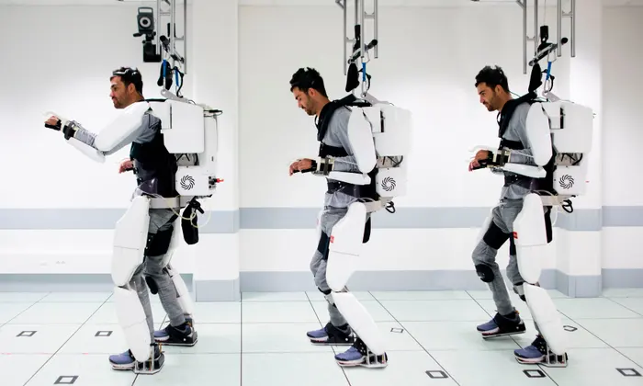
Motor Imagery Applications
Exoskeleton Control
Notes:
https://www.christopherreeve.org/living-with-paralysis/health/how-the-spinal-cord-works
https://www.theguardian.com/world/2019/oct/04/paralysed-man-walks-using-mind-controlled-exoskeleton

Slide 20

Brain-Computer Interface: P300

Slide 21
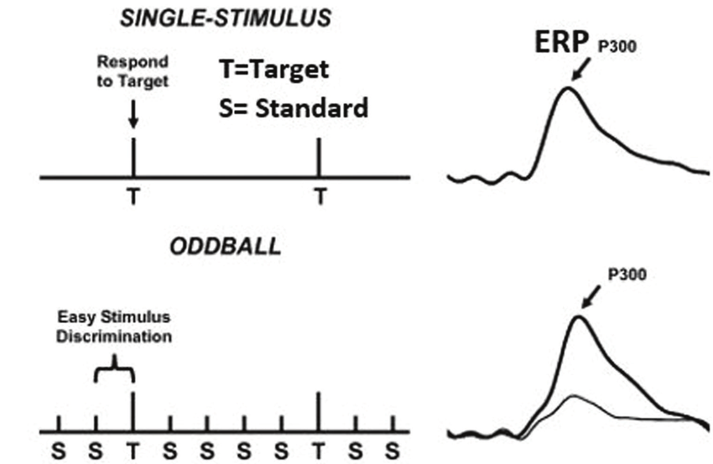
P300
P300 refers to a spike in activity approximately 300ms following presentation of the target stimulus, which is alternated with standard stimuli to create an ‘oddball’ paradigm
Notes:
https://library.neura.edu.au/schizophrenia/physical-features/functional-changes/electrophysiology/p300/

Slide 22
Other BCI Application Areas
Emotion Classification
Stress, workload detection
Neuromarketing

Slide 23
Emotion Classification

Slide 24

Brain-Computer Interface – Deep Brain Stimulation

Slide 25

Brain-Computer Interface – Entertainment

